Slide 1

Final Project
DSBA Visual Analytics – 5122
MANISH-VIJAY-NITIN

Slide 2
Objective
At the end of 2019, a novel coronavirus was identified as the cause of a cluster of pneumonia cases which rapidly spread, resulting in an epidemic, followed by an increasing number of cases in all the countries throughout the world. In February 2020, the World Health Organization designated the disease COVID-19, which stands for coronavirus disease 2019.
We would be exploring the COVID-19 data and analyze how the countries are preparing in this pandemic-:
Initial Insights and Introduction to Covid 19 Impact
Lockdown effectiveness and Healthcare Facility
Economic Stability and Response Indicators

Slide 3
Data Challenges and Preparation
Extracted data from multiple sources and wrangled data for analysis
Imputed the missing data by using different methods (mean, previous data)
Merge multiple indicators to show lockdown information
Build the master data from fact tables
Indicator High/Medium Low based on hospital bed
Created summarized view of economic stimulus and indicators using Oxford COVID-19 data
OXFORD COVID-19 Government Response
https://www.bsg.ox.ac.uk/research/research-projects/coronavirus-government-response-tracker
Oneworld Covid data
https://ourworldindata.org/coronavirus-source-data
WHO-COVID-19-global-data
Worldometer data
https://www.worldometers.info/coronavirus/

Slide 4
Design Process
Built the story , workflow and wireframe
Designed Shiny Layout with menu sidebar and main panel
Collaborative design for everyone to integrate code
Chose packages chose ggplot with shiny dashboard
Publish and install on shiny.io
Packages used ( Shiny, shinythemes, RColorBrewer, viridis, ggrepel, flexdashboard)

Slide 5
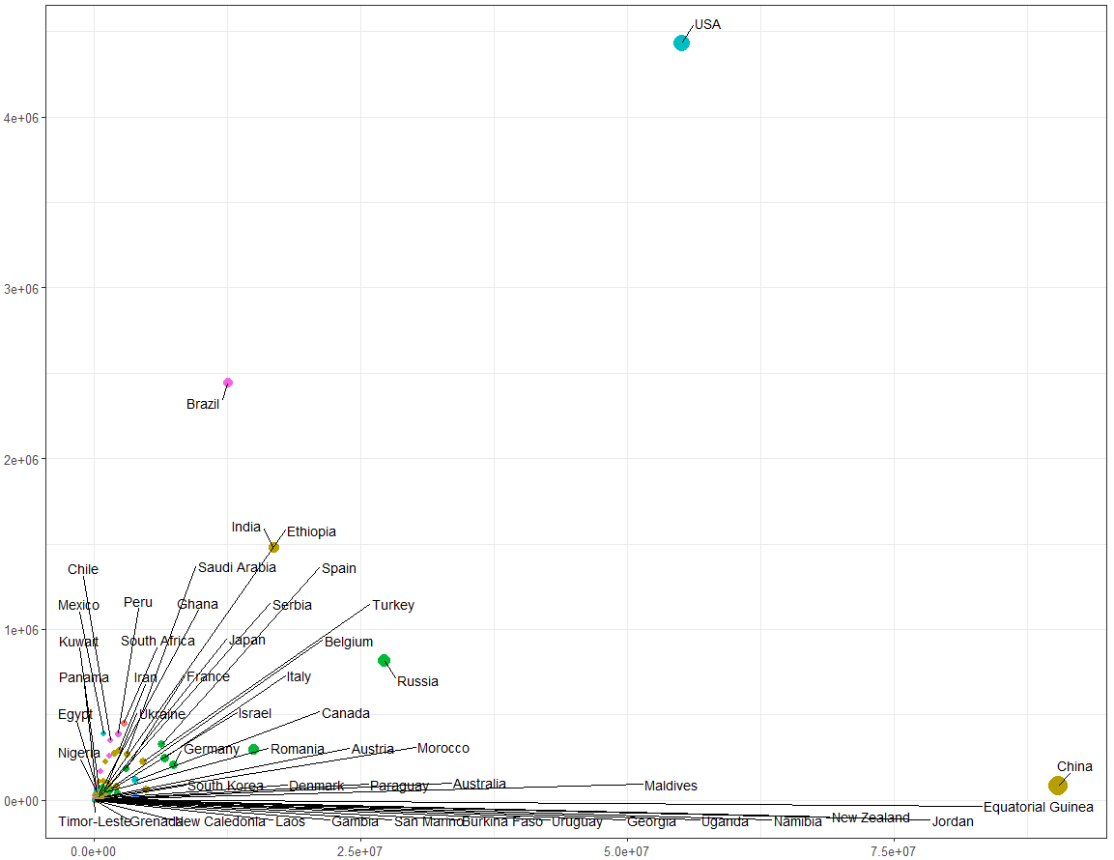
Introductory Analysis & Insights
To provide the useful insights about Covid-19 and its impact on different countries & no of people, we studied the Covid-19 infected data from worldometer
Integrated the complete dataset with information of confirmed cases, deaths, testing, recovered in shiny app
Prepared multiple options to choose custom views and axis to make it interactive for user
Shows the overall no of cases on dashboard after selecting the parameters
Helps in showing the trend of different countries with respect to cases, deaths and other parameters
For example in one of the attached plot, we can see that USA stands high among all other countries in terms of testing

Slide 6
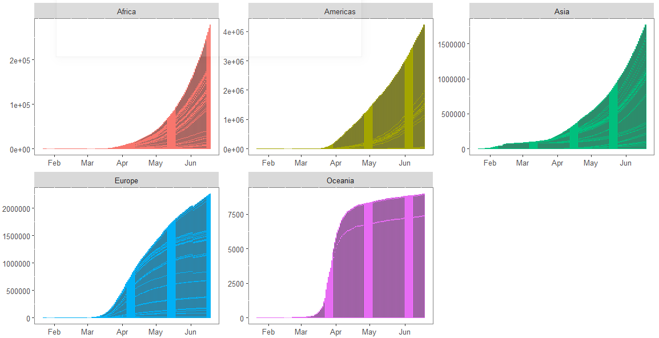
Introductory Analysis & Insights Continued
Provided time series option to analyze the various parameters
Interactive dashboard to show the confirmed, death or recovered cases over time
Helps in showing the trend and see the pattern of increase/decrease in no of cases as per parameter
Attached plot show the cases of Covid-19 as per different continents

Slide 7
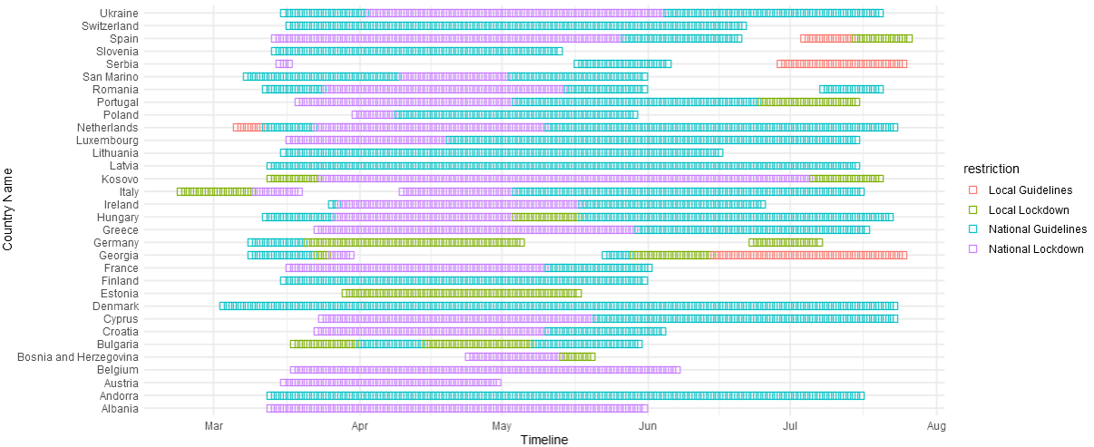
Lockdown Effectiveness
Various level of restrictions and guidelines were imposed which varied as per region and country to control Covid-19
Integrated different lockdown and restriction flags in shiny dashboard
Provides view of restriction imposed over time in various countries amidst of increasing corona cases
Option for user to customize the view as per continent
Helps to deduce when the lockdowns were eased say from national to local and if the situation improved

Slide 8
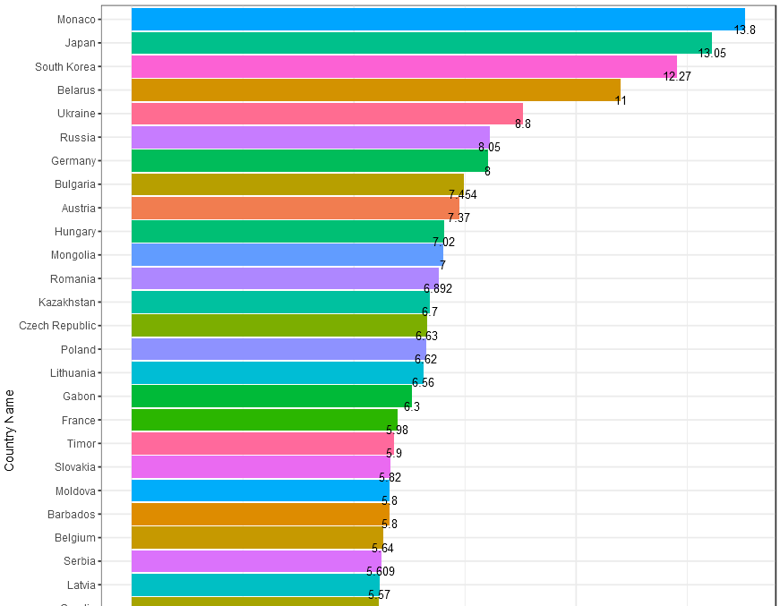
HealthCare Facility
Another parameter to see if the countries are ready is to show the availability of healthcare facility
Integrated the hospital beds data for every country to show the preparation and fight Covid-19
Plots no of hospital beds per 1000 population
Option for user to select tier-1, 2& 3 countries and top countries by using the bin button
Provides understanding of overall healthcare facility of different countries

Slide 9
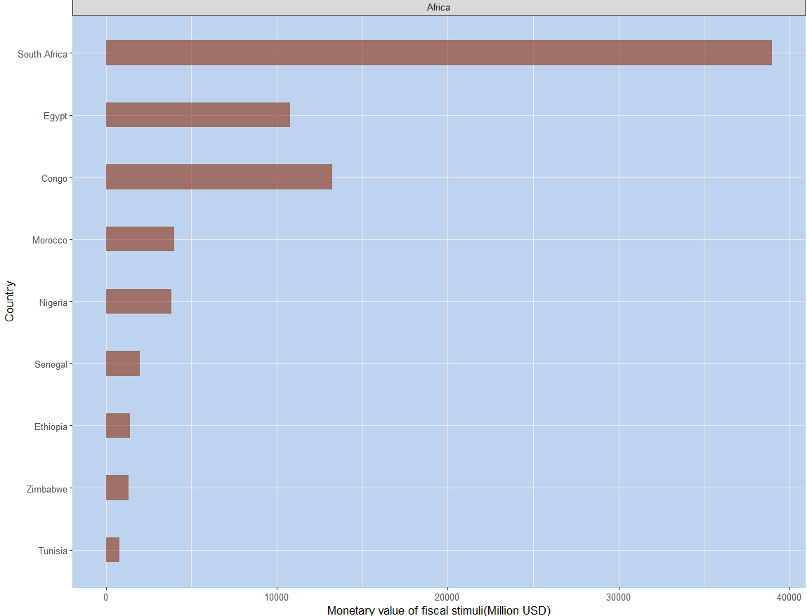
Economic Stability
Government launched various economic policies to tackle Covid-19 situation which varies for different countries
Announced economic stimulus spending intended to elicit and economic response from the private sector
Used the global data by integrating it in shiny dashboard
Provides interactive view of how different countries are doing and option to select the top countries by continent
This helps in identifying the countries across the globe which actively took measures to help the economy

Slide 10
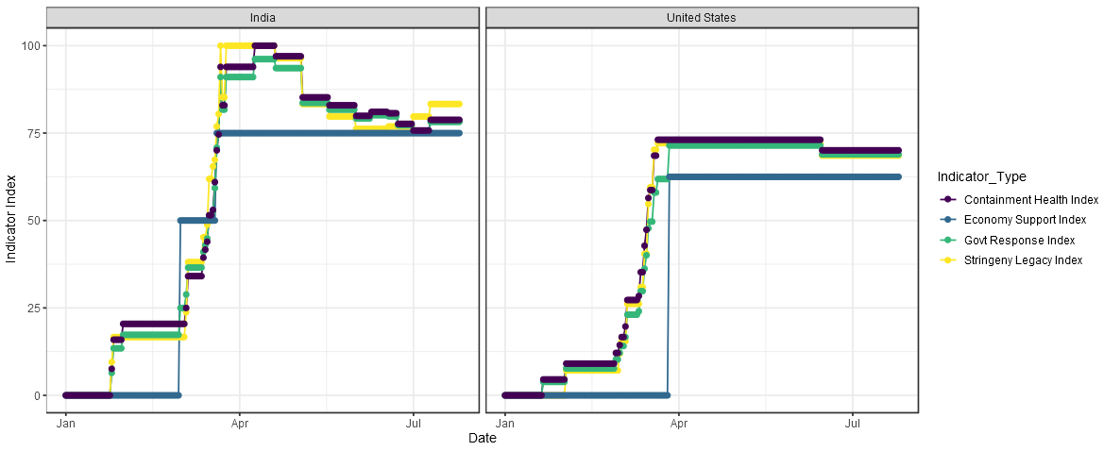
Response Indicators
Economic Stability and Indicators
Economic Stability and Indicators
Due to Covid-19, Countries across globe were measured in terms of their response to different indicators captured by Oxford Covid-19 Government Response Tracker
Used the Indicators to see the government response for lockdown, healthcare, economy
Integrated the indicators data of different countries within shiny app
provides option to compare multiple countries and see how they fared across different indicators
Helps to see the overall picture in terms of economic support provided or lockdown restrictions imposed at different times

